Slide 1

CIS 467 :Data Mining
Department of Information Systems
Faculty of Information Technology and Computer Sciences
Yarmouk University – Jordan
© Dr. Qasem Al-Radaideh
Notes:
1

Slide 2
Topic 7 Data Mining Applications and Trends
Main Source: J. Han Book
Data Mining: Concepts and Techniques (2nd Ed and 3rd Ed)
(Chapter 1 and Chapter 13)
2
Notes:
2

Slide 3
Outline
Data Mining Applications
Potential Applications of Data Classification in Real world
Mining Complex Data
Text Mining,
Mining the Web Data, and
Potential Applications
Social Impacts of Data Mining
New Trends and Case Studies
Potential Applications of Data Mining Jordan

Slide 4
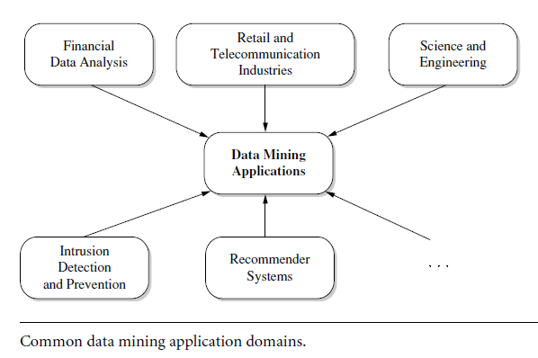
Data Mining Applications (What Kind of Applications Are Targeted)
As a young research field, data mining has made broad and significant progress since its early beginnings in the 1980s.
Today, data mining is used in a vast array of areas, and numerous commercial data mining systems are available.
As a highly application-driven discipline, data mining has seen great successes in many applications. It is impossible to enumerate all applications where data mining plays a critical role.

Slide 5
Business Intelligence
Business intelligence (BI) technologies provide historical, current, and predictive views of business operations. Examples include reporting, online analytical processing, business performance management, competitive intelligence, benchmarking, and predictive analytics.
Without data mining, many businesses may not be able to perform effective market analysis, compare customer feedback on similar products, discover the strengths and weaknesses of their competitors, retain highly valuable customers, and make smart business decisions.
Clearly, data mining is the core of business intelligence. Online analytical processing tools in business intelligence rely on data warehousing and multidimensional data mining. Classification and prediction techniques are the core of predictive analytics in business intelligence, for which there are many applications in analyzing markets, supplies, and sales. Moreover, clustering plays a central role in customer relationship management, which groups customers based on their similarities. Using characterization mining techniques, we can better understand features of each customer group and develop customized customer reward programs.

Slide 6
Data Mining for Financial Data Analysis
Most banks and financial institutions offer a wide variety of banking services (such as checking and savings accounts for business or individual customers), credit (such as business, mortgage, and automobile loans), and investment services (such as mutual funds).
Examples:
Loan payment prediction and customer credit policy analysis.
Classification and clustering of customers for targeted marketing.
Detection of money laundering and other financial crimes.

Slide 7
Data Mining for the Retail Industry
The retail industry is a major application area for data mining, since it collects huge amounts of data on sales, customer shopping history, goods transportation, consumption, and service. The quantity of data collected continues to expand rapidly, especially due to the increasing ease, availability, and popularity of business conducted on the Web, or e-commerce.
Today, many stores also have websites where customers can make purchases on-line. Some businesses, such as Amazon.com (www.amazon.com), exist solely on-line, without any brick-and-mortar (i.e., physical) store locations. Retail data provide a rich source for data mining.
Retail data mining can help identify customer buying behaviors, discover customer shopping patterns and trends, improve the quality of customer service, achieve better customer retention and satisfaction, enhance goods consumption ratios, design more effective goods transportation and distribution policies, and reduce the cost of business.
Examples:
Multidimensional analysis of sales, customers, products, time, and region.
Customer retention—analysis of customer loyalty.
Product recommendation and cross-referencing of items.

Slide 8
Data Mining for the Telecommunication Industry
The telecommunication industry has quickly evolved from offering local and long distance telephone services to providing many other comprehensive communication services, such as: cellular phone, Internet Messenger, images, e-mail, computer and Web data transmission, and other data traffic.
This creates a great demand for data mining in order to help:
understand the business involved,
identify telecommunication patterns,
catch fraudulent activities,
make better use of resources, and
improve the quality of service.
Examples:
Multidimensional analysis of telecommunication data.
Fraudulent pattern analysis and the identification of unusual patterns.
Multidimensional association and sequential pattern analysis.
Mobile telecommunication services.
Use of visualization tools in telecommunication data analysis.

Slide 9
Additional Potential Applications
Data analysis and decision support
Market analysis and management
Target marketing, customer relationship management (CRM), market basket analysis, cross selling, market segmentation
Risk analysis and management
Forecasting, customer retention, improved underwriting, quality control, competitive analysis
Fraud detection and detection of unusual patterns (outliers)
Other Applications
Stream data mining
Bioinformatics and bio-data analysis

Slide 10
An Nice Example of one of the major Applications of Data Mining : Fraud Detection & Mining Unusual Patterns
Applications: Health care, retail, credit card service, telecomm.
Auto insurance: ring of collisions
Money laundering: suspicious monetary transactions
Medical insurance
Professional patients, ring of doctors, and ring of references
Unnecessary or correlated screening tests
Telecommunications: phone-call fraud
Phone call model: destination of the call, duration, time of day or week. Analyze patterns that deviate from an expected norm
Retail industry
Analysts estimate that 38% of retail shrink is due to dishonest employees
Anti-terrorism
Approaches: Clustering & model construction for frauds, outlier analysis

Slide 11
Dear Student: If you like to read about more examples, Following are some Examples from Book ENJOY

Slide 12
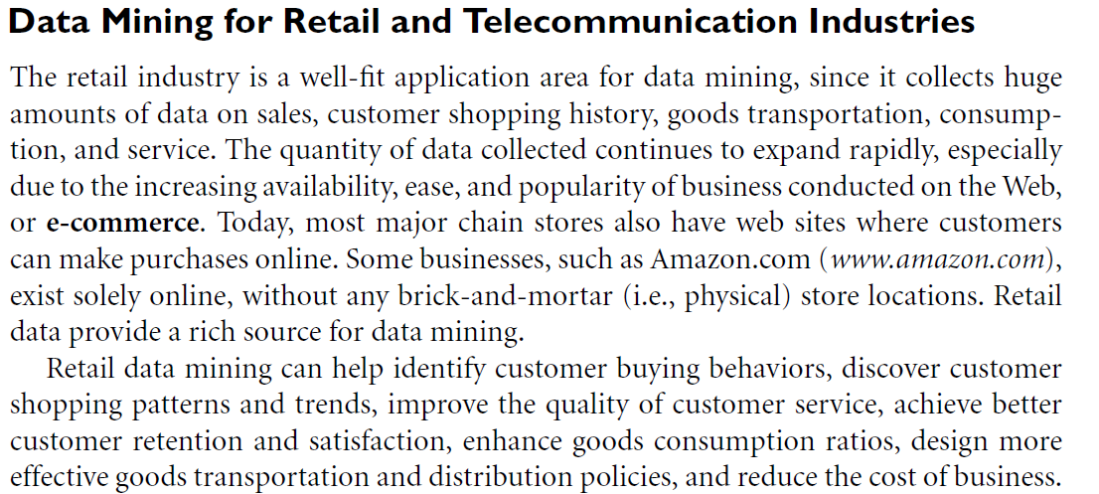

Slide 13
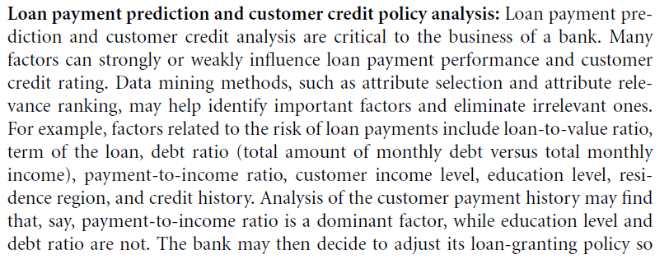

Slide 14
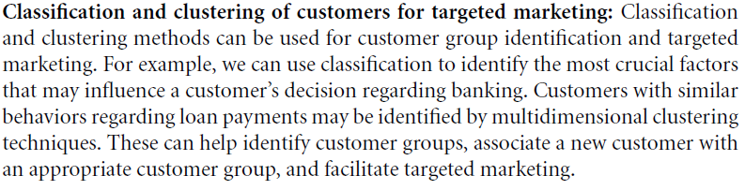

Slide 15
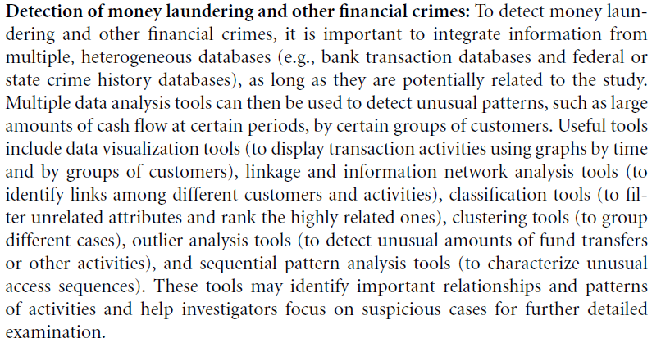

Slide 16
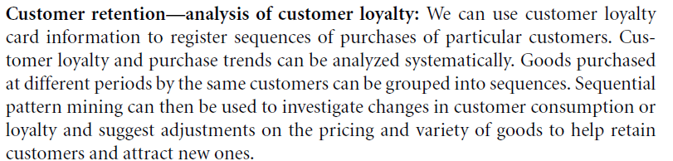

Slide 17
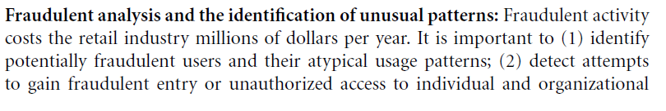
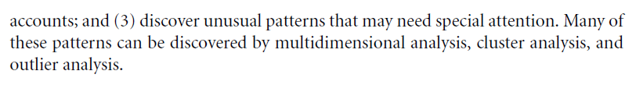
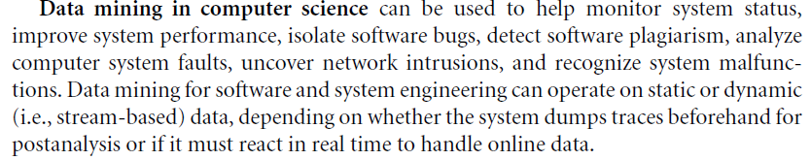

Slide 18
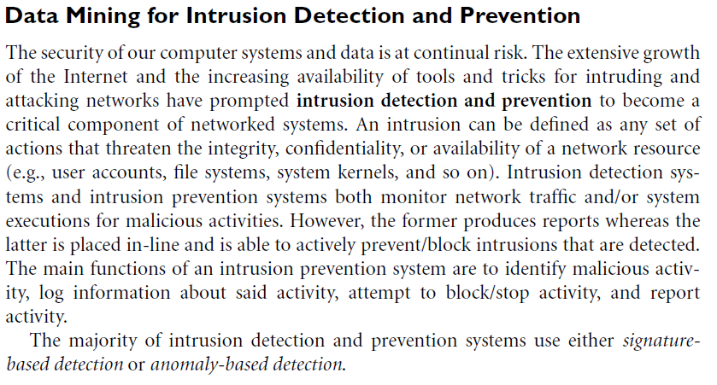

Slide 19
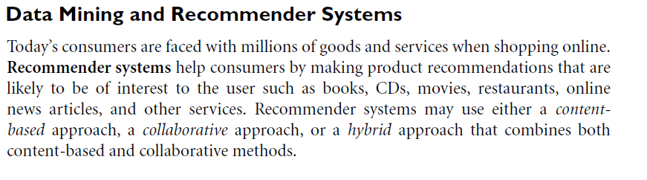

Slide 20

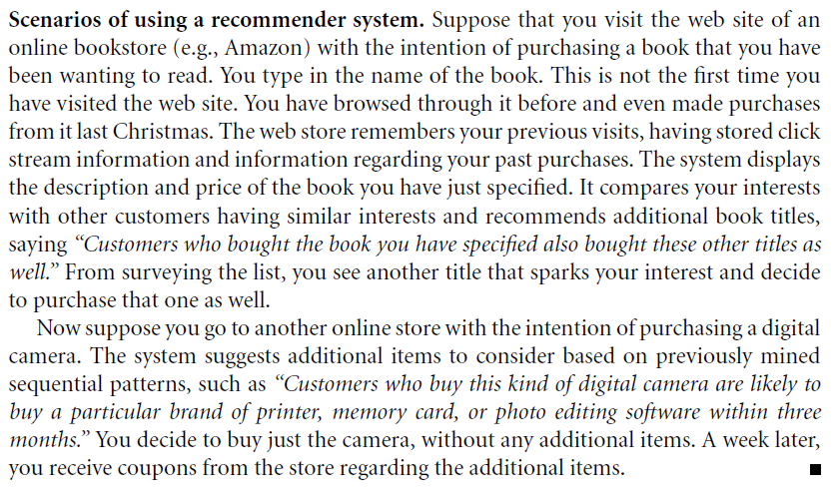

Slide 21
Mining Complex Data Types

Slide 22
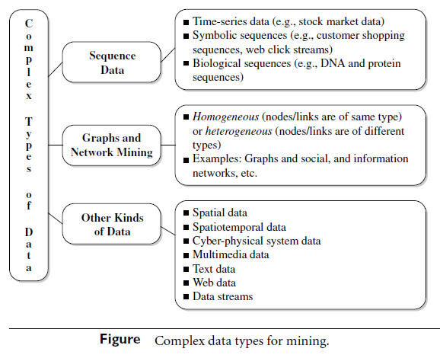
Mining Complex Data Types

Slide 23
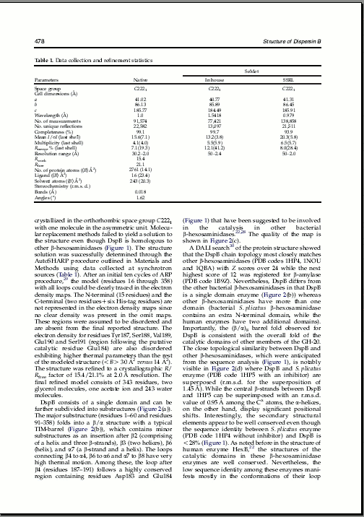
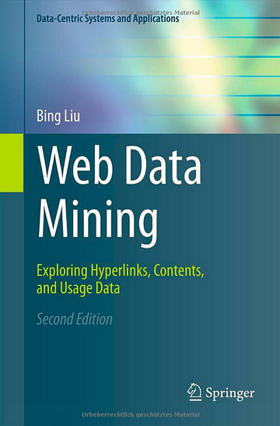

Mining Multimedia, Text and Web Data:
An Introduction
Data Mining / Knowledge Discovery
Structured Data Multimedia Free Text Hypertext
HomeLoan (
Loanee: Frank Rizzo
Lender: MWF
Agency: Lake View
Amount: $200,000
Term: 15 years
)
Frank Rizzo bought
his home from Lake
View Real Estate in
1992.
He paid $200,000
under a15-year loan
from MW Financial.
<a href>Frank Rizzo
</a> Bought
<a hef>this home</a>
from <a href>Lake
View Real Estate</a>
In <b>1992</b>.
<p>...
Loans($200K,[map],...)
Notes:
Throughout this course we have been discussing Data Mining over a variety of data types.
Two former types we covered were Structured Data (relational) and multimedia data.
Today and in the last class we have been discussing Data Mining over free text,
and our next section will cover hypertext, such as web pages.
Text mining is well motivated, due to the fact that much of the world’s data can be
found in free text form (newspaper articles, emails, literature, etc.). There is a
lot of information available to mine.
While mining free text has the same goals as data mining in general
(extracting useful knowledge/stats/trends), text mining must overcome
a major difficulty – there is no explicit structure.
Machines can reason will relational data well since schemas are explicitly available.
Free text, however, encodes all semantic information within natural language. Our
text mining algorithms, then, must make some sense out of this natural language
representation. Humans are great at doing this, but this has proved to be a problem for machines.

Slide 24
Mining Multimedia Data
Multimedia data mining is the discovery of interesting patterns from multimedia databases that store and manage large collections of multimedia objects, including image data, video data, audio data, as well as sequence data and hypertext data containing text, text markups, and linkages.
Multimedia data mining is an interdisciplinary field that integrates image processing and understanding, computer vision, data mining, and pattern recognition.
Issues in multimedia data mining include: content-based retrieval and similarity search, and generalization and multidimensional analysis.
Other topics in multimedia mining include: classification and prediction analysis, mining associations, and video and audio data mining

Slide 25
Text Mining
Source: The Book and Some Sources from the Internet
25
Notes:
25

Slide 26
Mining Text Data
Text mining (TM) is an interdisciplinary field that draws on information retrieval, data mining, machine learning, statistics, and computational linguistics.
Text mining is about looking for patterns in text: It is the process of analyzing text to extract information that is useful for particular purposes.
Compared with the kind of data we have been talking about in this course, text is unstructured, amorphous, and difficult to deal with.
An important goal for TM is to derive high-quality information from text.
Text mining usually requires structuring the input text (e.g., parsing)

Slide 27
Text Mining Motivation
Motivation: Approximately 90% of the world’s data is held in unstructured formats (source: Oracle Corporation).
Sources of textual information:
Email
News articles
Web pages
Patent portfolios
Books
Customer communications
Contracts
Technical documents
Insurance claims
Scientific articles
Plus add your own!
Structured Numerical or Coded
Information
10%
Unstructured or Semi-structured
Information
90%
Notes:
The justification for the interest in text mining is the same as for the interest in knowledge retrieval (search and categorization).
The shear amount of unstructured data (mostly textual) out there calls for more than just document retrieval. Tools and techniques exist to mine this data and realize value in the same way that data mining taps structured data for business intelligence and knowledge discovery.

Slide 28
Text Databases and IR
Text databases (document databases)
Large collections of documents from various sources: news articles, research papers, books, digital libraries, e-mail messages, and Web pages, library database, etc.
Data stored is usually semi-structured
Traditional information retrieval techniques become inadequate for the increasingly vast amounts of text data
Information retrieval
A field developed in parallel with database systems
Information is organized into (a large number of) documents
Information retrieval problem: locating relevant documents based on user input, such as keywords or example documents
Text Mining (or Information Extraction)
Extract from the text what the document means.

Slide 29
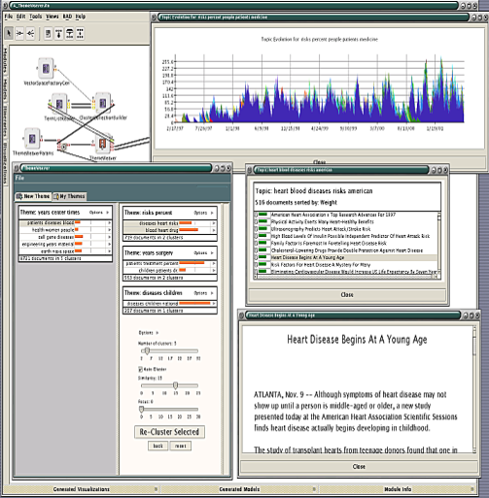
Text Mining Applications
Marketing: Discover distinct groups of potential buyers according to a user text based profile
e.g. amazon
Industry: Identifying groups of competitors web pages
e.g., competing products and their prices
Job seeking: Identify parameters in searching for jobs
e.g., www.flipdog.com
Biomedical Data: Extract pieces of evidence from article titles in the biomedical literature
“stress is associated with migraines”
“stress can lead to loss of magnesium”
“calcium channel blockers prevent some migraines”
“magnesium is a natural calcium channel blocker”

Slide 30
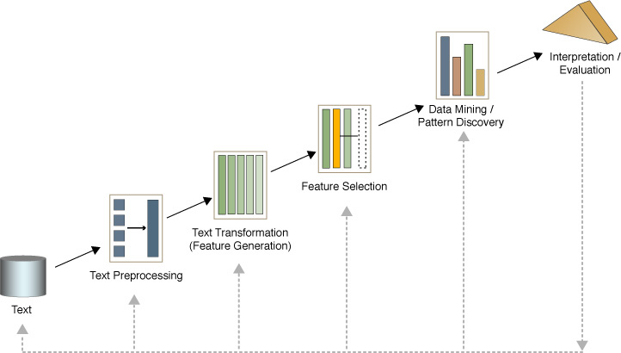
Text mining process
Text preprocessing
Syntactic/Semantic text analysis
Tokenization and Text Clean up
Text Tagging
Features Generation
Bag of words
Features Selection
Simple counting
Statistics
Text/Data Mining
Classification- Supervised learning
Clustering- Unsupervised learning
Analyzing results

Slide 31
Text Mining Tasks
Text mining can address the same basic tasks as data mining
Text classification,
Text clustering,
Text Summarization
Documents Association
etc.).
The difference is that text is more difficult to mine than structured data.
E.g., in document clustering, we can transform the documents into vectors using text processing techniques and the vector model, and then apply a clustering algorithm to the docs

Slide 32
Document Classification
Document classification, in which each instance represents a document and the instance’s class is the document’s topic.
Documents are characterized by the words that appear in them. The presence or absence of each word can be treated as a Boolean attribute, or documents can be treated as bags of words, rather than sets, by taking word frequencies into account.

Slide 33
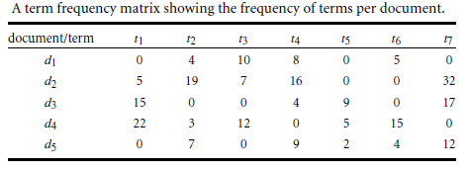
Bag-of-Tokens : Example
Documents
Token Sets
Four score and seven years ago our fathers brought forth on this continent, a new nation, conceived in Liberty, and dedicated to the proposition that all men are created equal.
Now we are engaged in a great civil war, testing whether that nation, or …
nation – 5
civil - 1
war – 2
men – 2
died – 4
people – 5
Liberty – 1
God – 1
…
Feature
Extraction
Notes:
The previous text mining presentations “made sense” out of free text by
viewing text as a bag-of-tokens (words, n-grams). This is the same approach as IR.
Under that model we can already summarize, classify, cluster, and compute co-occurrence stats over free text.
These are quite useful for mining and managing large volumes of free text.
However, there is a potential to do much more. The BOT approach loses a LOT of information
contained in text, such as word order, sentence structure, and context. These are precisely the
features that humans use to interpret text.
Thus the natural question is can we do better?

Slide 34
Web Mining
Source: The Book and Some Sources from the Internet
34
Notes:
34

Slide 35
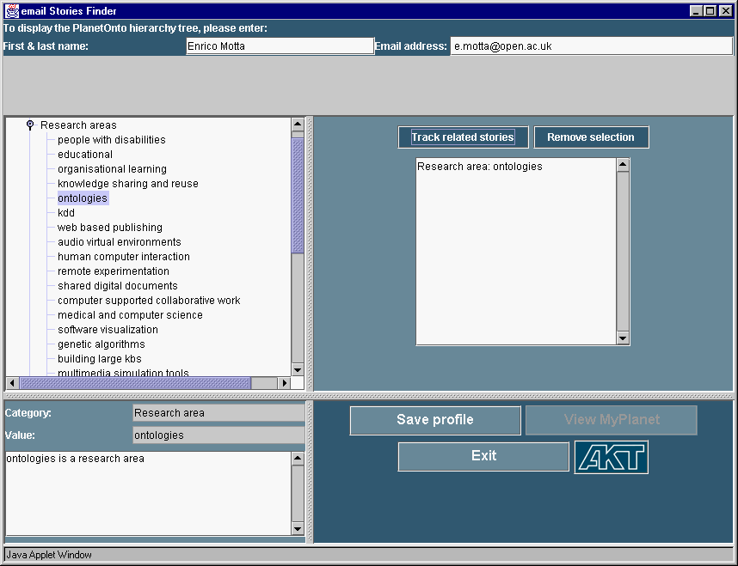
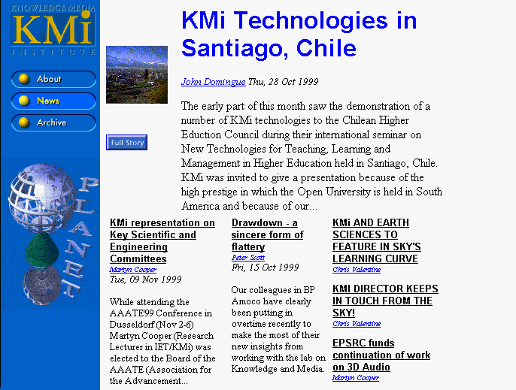

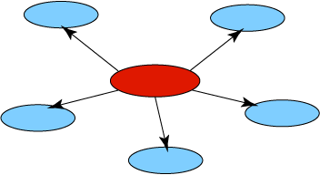
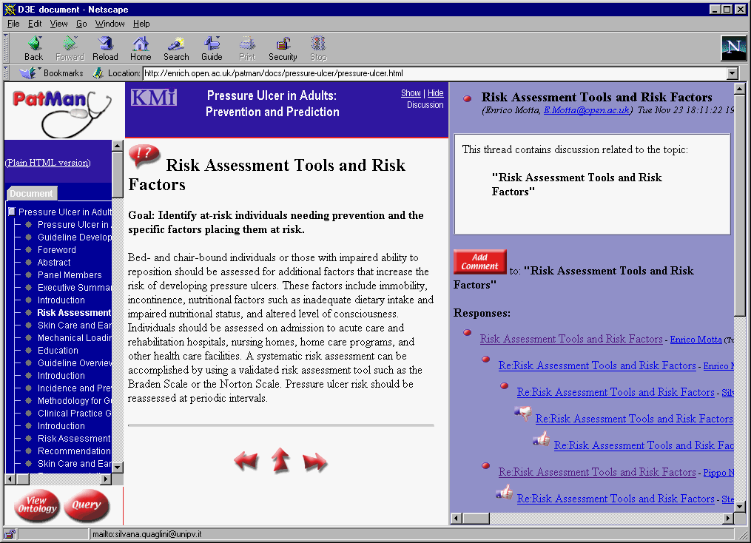
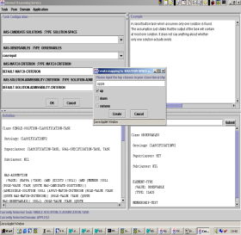
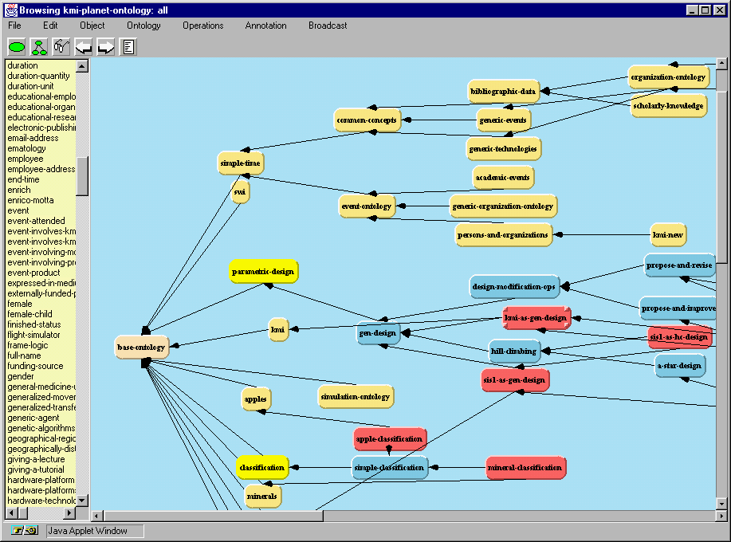
What about Web Data
…to get more info about the user than he has about himself...
Knowledge

Slide 36
Web Mining: Introduction
The World Wide Web is a rich, enormous knowledge base that can be useful to many applications.
Billion of pages contributed by millions of Web page authors and organizations
Knowledge analysis: The content of the web pages, characteristics of the Web, e.g., the hyperlink structure and diversity of languages.
Such knowledge can be used to improve users’ efficiency and effectiveness in searching for information on the web.
Also it can be used for other applications NOT related to the web, e.g., decision-making support or business management.
The Web’s large size and its unstructured and dynamic content, as well as its multilingual nature make extracting useful knowledge from it a challenging research problem.
Machine Learning techniques can be a possible approach to solve these problems and also Data Mining has become a significant subfield in this area.
The various activities and efforts in this area are referred to as Web Mining.

Slide 37
What is web mining
Web Mining is the extraction of interesting and potentially useful patterns and implicit information from artifacts or activity related to the World­Wide Web.
Web Mining: discover useful information or knowledge from the Web hyperlink structure, page content, and usage data.
The term Web Mining produced to denote the use of Data Mining techniques to automatically discover Web documents and services, extract information from Web resources, and uncover general patterns on the Web.
Web mining research overlaps substantially with other areas, including data mining, text mining, information retrieval, and web retrieval.

Slide 38
Web Mining Categories
Web Mining research can be classified into 3 main categories:
Web content mining: refers to the discovery of useful information from Web contents, including text, images, audio, video, etc.
Web structure mining: studies the model underlying the link structures of the Web.
Web usage mining: focuses on using data mining techniques to analyze search logs to find interesting patterns.

Slide 39
Web content mining
Web content mining analyzes web content such as text, multimedia data, and structured data (within web pages or linked across web pages).
This is done to understand the content of web pages, provide scalable and informative keyword-based page indexing, entity/concept resolution, web page relevance and ranking, web page content summaries, and other valuable information related to web search and analysis.
Web content mining has been studied extensively by researchers, search engines, and other web service companies. Web content mining can build links across multiple web pages for individuals; therefore, it has the potential to inappropriately disclose personal information.

Slide 40
Web structure mining
Web structure mining is the process of using graph and network mining theory and methods to analyze the nodes and connection structures on the Web.
It extracts patterns from hyperlinks, where a hyperlink is a structural component that connects a web page to another location.
It can also mine the document structure within a page (e.g., analyze the treelike structure of page structures to describe HTML or XML tag usage).
Both kinds of web structure mining help us understand web contents and may also help transform web contents into relatively structured data sets.

Slide 41
Web usage mining
Web usage mining is the process of extracting useful information (e.g., user click streams) from server logs. It finds patterns related to general or particular groups of users; understands users’ search patterns, trends, and associations; and predicts what users are looking for on the Internet.
It helps improve search efficiency and effectiveness, as well as promotes products or related information to different groups of users at the right time.
Web search companies routinely conduct web usage mining to improve their quality of service.

Slide 42
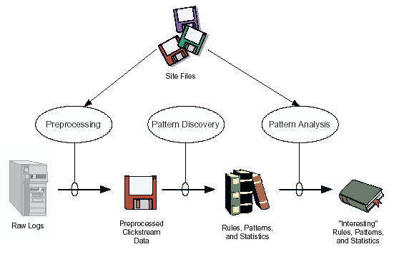
Web Usage Mining - Applications
Target potential customers for electronic commerce
Enhance the quality and delivery of Internet information services to the end user
Improve Web server system performance
Identify potential prime advertisement locations
Facilitates personalization/adaptive sites
Improve site design
Fraud/intrusion detection
Predict user’s actions (allows prefetching)

Slide 43
Web Usage Mining Techniques
Web Usage Mining:
Main techniques:
Clustering:
to find groups of users who share similar browsing behavior
Classification:
to categorize Web users according to their past access history
Association Rules:
to determine what are the set of page views often accessed together in the same server session

Slide 44
Examples:
Association rules in Web-logs
Searching for rules that connect two or more events:
60% of the users that visited URL/company/product, also visited company/product/product1.html
30% of the users that visited URL/company/special-offer/ also visited company/product2.html
Classification rules:
Identification of behavior for groups of users - additional information can be obtained from cookies, registration, etc…
Users that frequently visit page /company/products/product3.html are from educational institutions
50% of the users that visited /company/products/product4.html are in age group of 20-25 and live at the see coast

Slide 45
Who use Web Mining Applications.
Amazon.com
Google
Double Click
AOL
eBay
MyYahoo

Slide 46
Case Studies

Slide 47
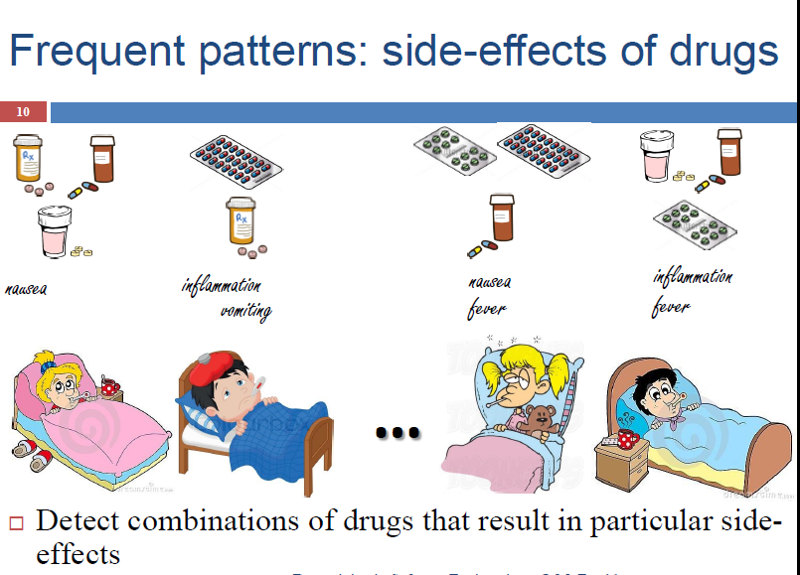

Slide 48
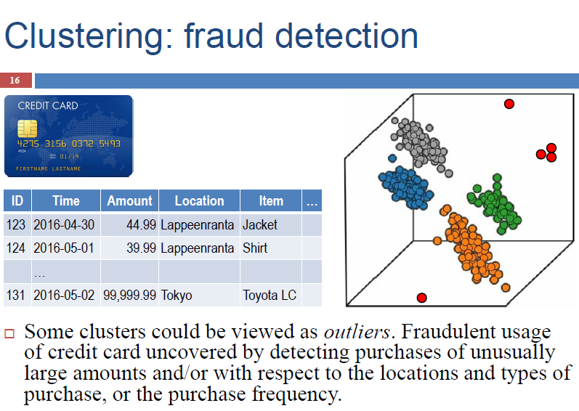

Slide 49
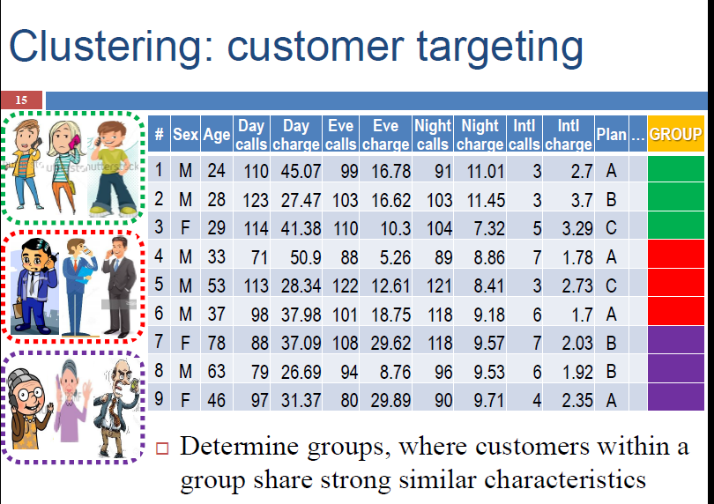

Slide 50
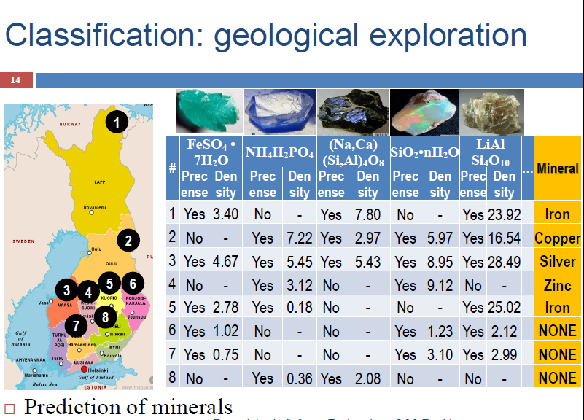

Slide 51
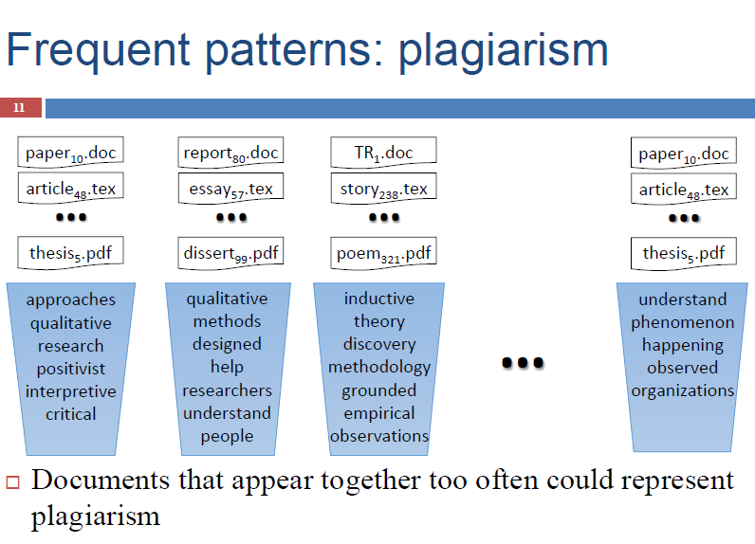

Slide 52
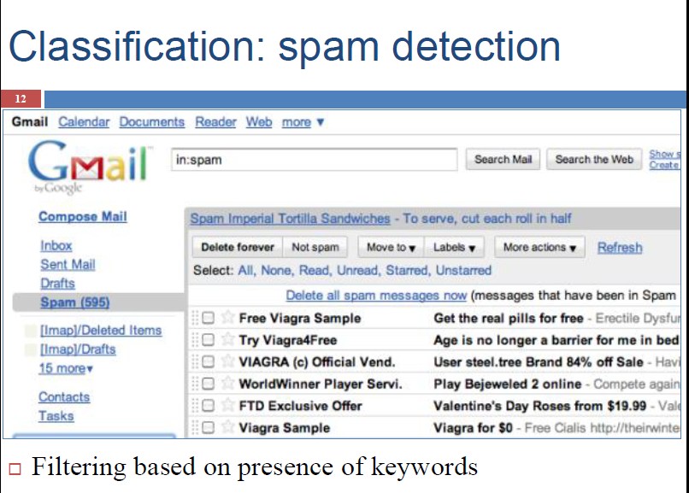

Slide 53
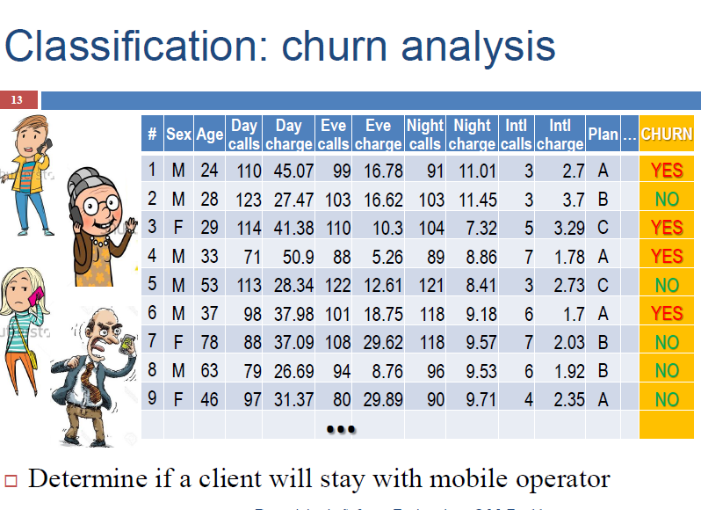

Slide 54
Data Mining and Social Impacts
Main Source: J. Han Book
Data Mining: Concepts and Techniques (3nd ed.)
(Chapter 13)
54
Notes:
54

Slide 55
Data Mining: Merely Managers' Business or Everyone's?
Data mining will surely be an important tool for managers’ decision making
Bill Gates: “Business @ the speed of thought”
The amount of the available data is increasing, and data mining systems will be more affordable
Multiple personal uses
Mine your family's medical history to identify genetically-related medical conditions
Mine the records of the companies you deal with
Mine data on stocks and company performance, etc.
Invisible data mining
Build data mining functions into many intelligent tools

Slide 56
Social Impacts: Threat to Privacy and Data Security?
Is data mining a threat to privacy and data security?
“Big Brother”, “Big Banker”, and “Big Business” are carefully watching you.
Profiling information is collected every time
You use your credit card, debit card, supermarket loyalty card, or frequent flyer card, or apply for any of the above
You surf the Web, reply to an Internet newsgroup, subscribe to a magazine, rent a video, join a club, fill out a contest entry form,
You pay for prescription drugs, or present you medical care number when visiting the doctor.
Collection of personal data may be beneficial for companies and consumers, there is also potential for misuse

Slide 57
Protect Privacy and Data Security
Fair information practices
International guidelines for data privacy protection
Cover aspects relating to data collection, purpose, use, quality, openness, individual participation, and accountability
Purpose specification and use limitation
Openness: Individuals have the right to know what information is collected about them, who has access to the data, and how the data are being used.
Develop and use data security-enhancing techniques
Blind signatures
Biometric encryption
Anonymous databases

Slide 58

Data mining and ethics I
Ethical issues arise in practical applications
Anonymizing data is difficult
85% of Americans can be identified from just zip code, birth date and sex
Data mining often used to discriminate
E.g. loan applications: using some information (e.g. sex, religion, race) is unethical
Ethical situation depends on application
E.g. same information ok in medical application
Attributes may contain problematic information
E.g. area code may correlate with race

Slide 59
Data mining and ethics II
Important questions:
Who is permitted access to the data?
For what purpose was the data collected?
What kind of conclusions can be legitimately drawn from it?
Caveats must be attached to results
Purely statistical arguments are never sufficient!
Are resources put to good use?

Slide 60
Homework Potential Applications of Data Mining in Jordan
Think about it and write ONE page
60
Notes:
60

Slide 61
End of Course DONE
With best and warm wishes
61
Notes:
61

